Slide 1

Senior Project
Presentation
Nicholas Morin

Slide 2

Introduction
Summer 2019 – Hired as Intern at Community Software Group
  Community Software Group: Established in 1993
  Develops software that aids social service agencies and state government offices.
Project – Develop an API for a modular appointment system.
  Needed to be configurable for different agencies to use.
  A frontend had not yet been fully developed.
Notes:
Each agency has their own way of scheduling appointments, so the API had to be able to tailor to any specific need.

Slide 3
Objectives
Initial Project Objectives
  Brainstorm and produce different case stories that tailor towards each agencies' needs.
  Develop endpoint methods based off the case stories.
  Test each method using third party software. (Postman)
  Document each method
Objectives Added Post Proposal
  Develop unit tests for each endpoint method
Notes:
Each case story was reviewed and discussed with client

Slide 4
Demonstration
Organization of Data:
  Database: Microsoft SQL Server
  Structure: Each tuple is considered an “Appointment slot”
    SlotId – Unique Id and primary key
    Date & Time – When the appointment takes place
    ApptJson – Holds all information pertaining to appointment
    Timestamp – surprise, just a timestamp
{
SlotId: 7,
Date: "2020-06-10 00:00:00.000",
Time: "11:30:00.0000000",
ApptJson: null,
Timestamp: null
}
Notes:
Two Tables called AppointmentSlots and OfficeLocations
Use example of fuel assistance appointment scheduling

Slide 5
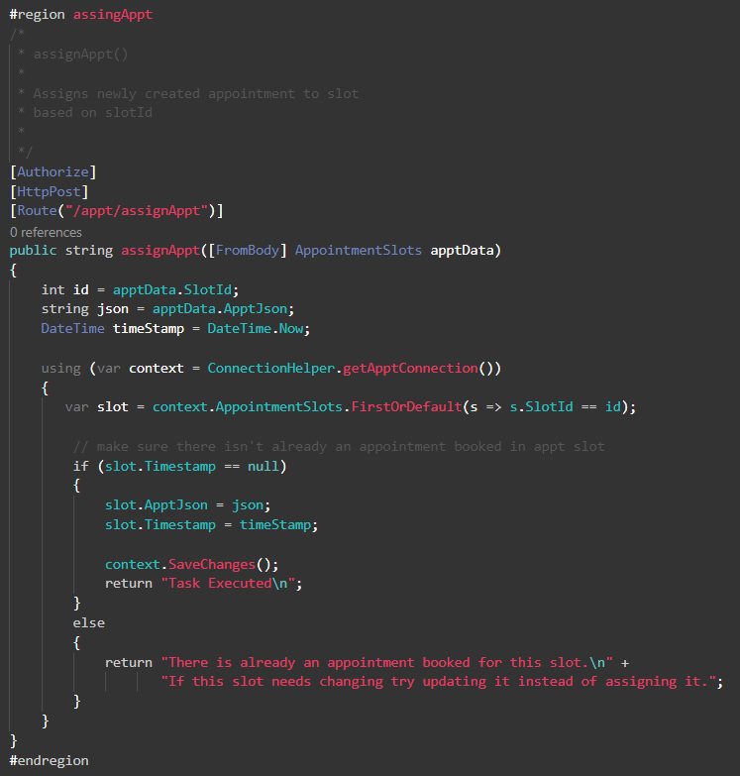
Notes:
Written in C#
Uses .NET Core with Entity Framework

Slide 6
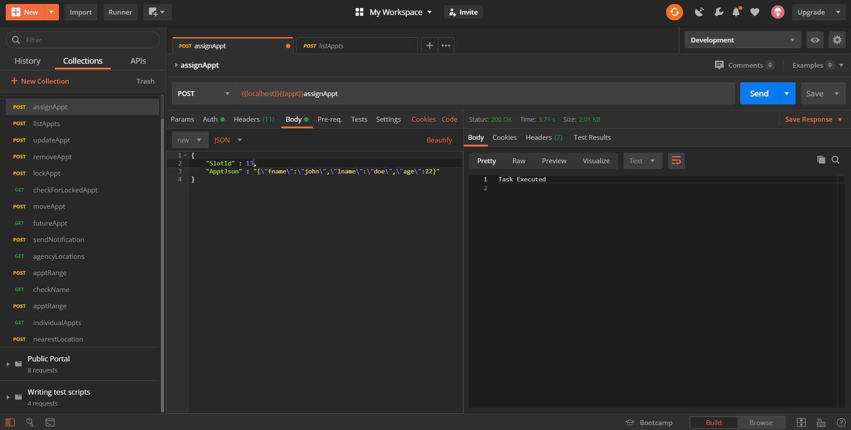

Slide 7
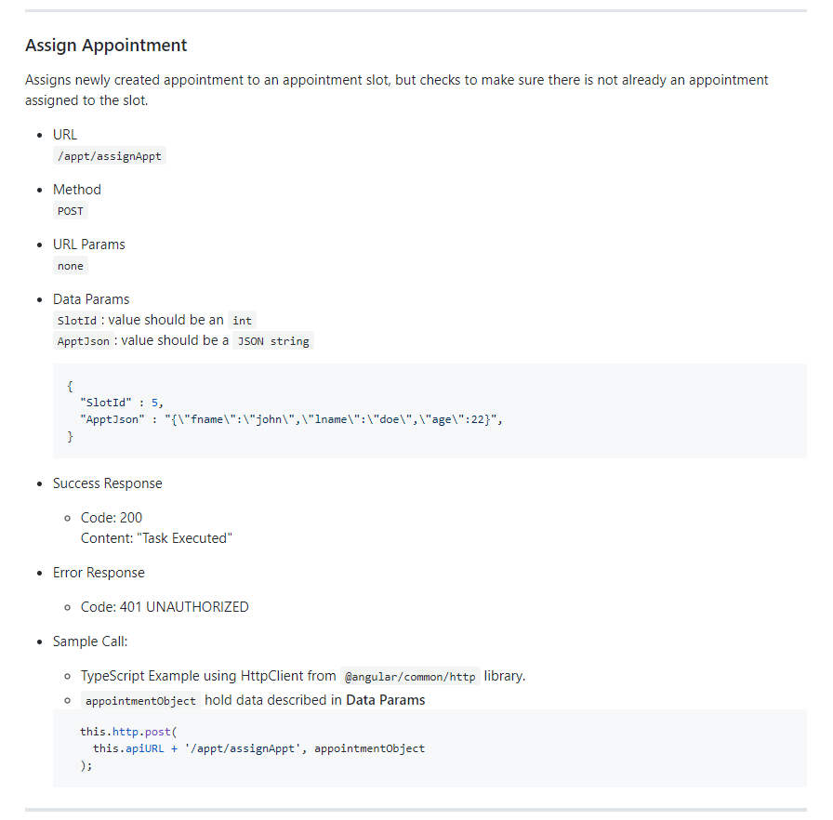

Slide 8
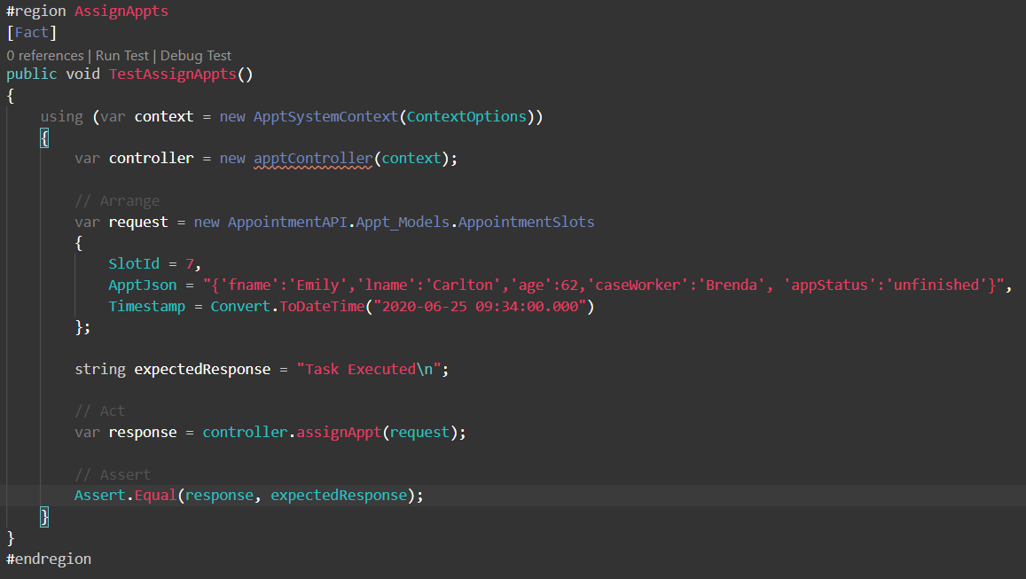
Unit Tests
Testing EF Code – 3 approaches
  Production database system
  SQLite – in-memory database
  EF Core in-memory database
The SQLite in-memory approach was taken.
Challenges – configuration
  Tests couldn’t be found by compilers
  Mocking DbContext
  Using mocked context in the controller methods
Notes:
InMemory does not support a relational database while sqlite does.

Slide 9
Fun Facts
14 endpoints were developed.
18 unit tests were written.
Between the controller and unit test files there are over 1,000 lines of code.
At least 120 hours were spent on this project (don’t ask for actual hour count)
Configured GitHub actions to build and test project on each commit

Slide 10
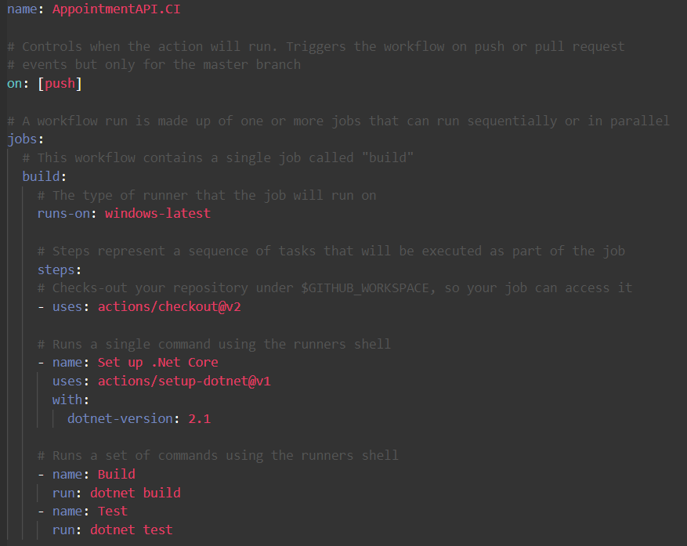

Slide 11
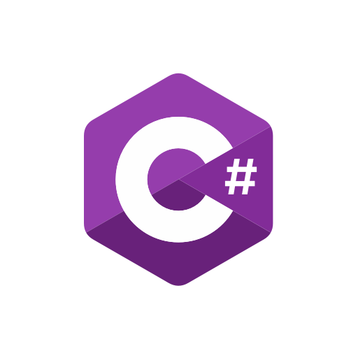




Conclusion
Gained knowledge and experience in:
  C#
  .NET Core & Entity Framework
  Documentation
  Development process
  Testing process (unit and automation)

