Slide 1
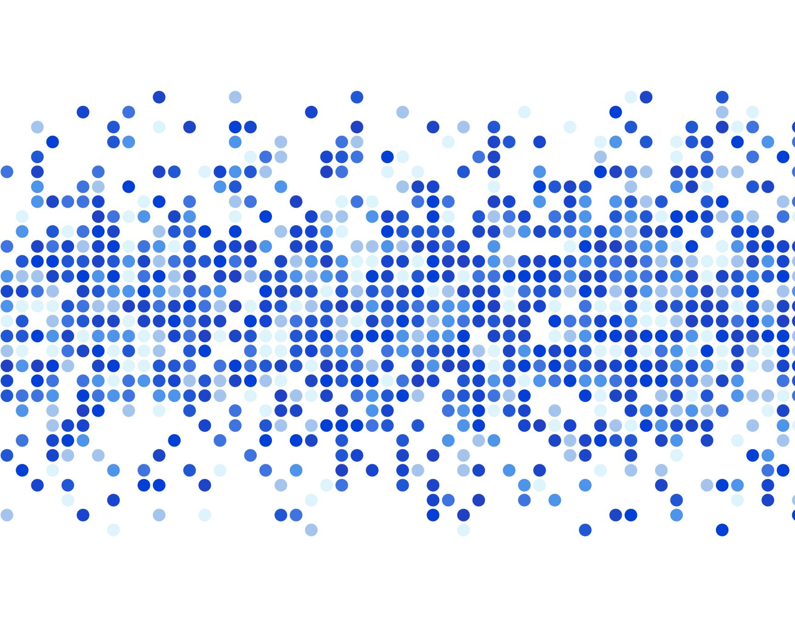
BMT Roku App
by Nick Perry

Slide 2
Why a Roku App?
Customer – Blue Mountain Television
Local
By improving a local business’s product, the community would benefit directly.
Approx. 3,000 monthly viewers
Application dev. as an interest
Favorite classes: Web-dev, Web-app dev, Mobile-app dev
Learning to use unfamiliar tools, resources, & strategies to develop on unfamiliar platforms
Roku as an opportunity to learn new platform, learn how to learn

Slide 3
Original Goals
The original project was meant to be an update to the current BMT Roku app
due to various unforeseen circumstances (that will be later explained), an update was no longer a realistic goal, and instead I moved forward with making an app from scratch.
Original app’s structure included:
Rows represented series; each row element was an ep. of said series
The main goals of the update were:
Have rows represent genres (e.g. Recent Additions, Nature, Spiritual, etc.)
Elements of rows would be series, rather than merely episodes
Selecting any series would open a details page involving seasons, descriptions, etc.

Slide 4
The Journey / Challenges
BMT’s original Roku app was developed by an independent contractor
He had sole access to the code, JSON hosting, everything. Then he retired
I needed the source code before I could begin learning about the program & upgrading it
I read documentation regarding setting up the development environment
Often (seemingly) outdated
I learned about the Roku web-portal for testing (clunky)
Overcame some basic struggles & misunderstandings regarding the Roku plugin for Eclipse IDE (thanks professor Carman)
I read lots of Roku documentation regarding their custom scripting language: Brightscript.
Utilizes system of screens & nested nodes (tree structure), similar to mobile-app dev
Learned various custom functions & syntax, looked at example code, made Hello World

Slide 5
Challenges cont.
It turned out that there was no realistic/easy way for us to get the source code from the original developer.
The code was connected to his personal accounts, he didn’t want to share that info (understandable), and there was no clear way to transfer code.
This was learned after weeks without a response from him
New goal: make the app from scratch.
If I couldn’t update the old app, I could at least build from the ground up to where their app currently was, and allow them full access to all aspects (via github & BMT’s own servers

Slide 6
Challenges cont.
Elusive errors
During testing, small portions of the program worked correctly, but I couldn’t get all the video data to show at once
after weeks of rewriting code structure to improve processing efficiency with no luck, I turned to Unit testing hoping to gather more information
Turns out my code was adequate & correct the entire time, some of the JSON data had been incorrect, and was causing the app to fail.

Slide 7
Final Product
I have created a fully functioning Roku app for Blue Mountain Television.
This app (unlike v1.0) will be fully accessible to BMT via a GitHub repository
The JSON data will be accessed via servers fully maintained & accessible by BMT
This will allow the structure & resources to be in place for the next developer to (eventually) implement the update that BMT originally wanted.
The program includes a fully functioning home-screen, a details/play screen for each video, and video-streaming
The program is organized, commented, and easily understandable
Smaller thumbnail images for episodes will improve processing & display speeds
Once fully uploaded to the servers, these smaller images may improve memory management efficiency considerably (8.3MB v.s. 0.16MB)

Slide 8
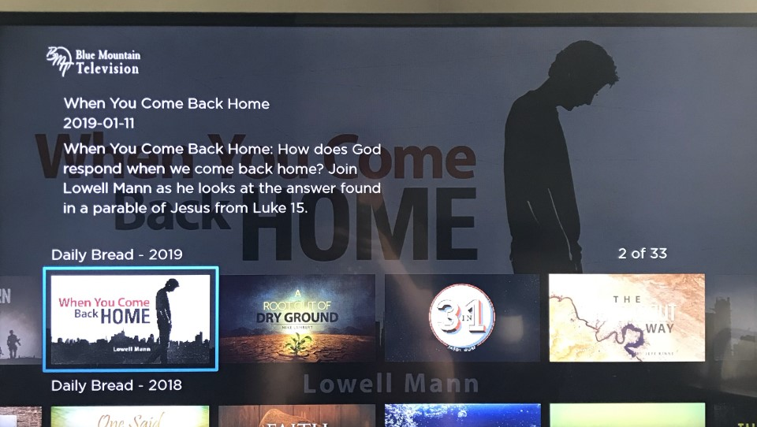

Slide 9
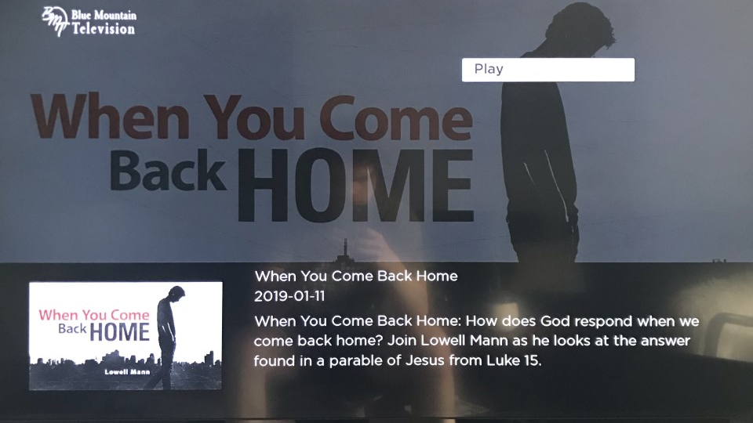

Slide 10
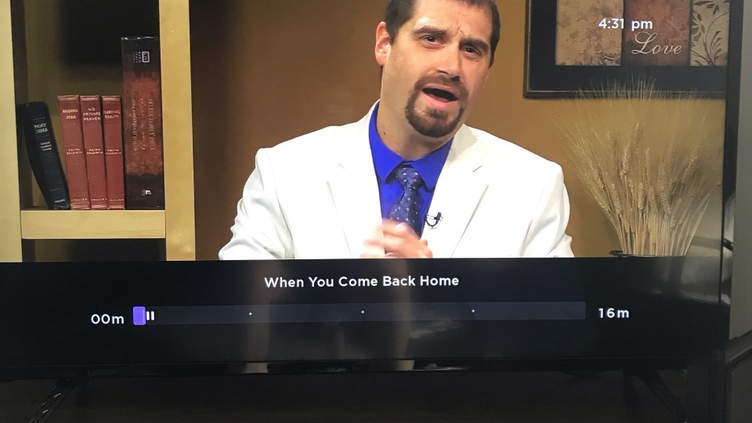

Slide 11
(Finishing Up?)
I have yet to turn over the GitHub account to BMT
I’m waiting for them to change the location of where the JSON is hosted, so I can run my tests and change a few lines of code accordingly.
A Roku developer account still needs to be made
Covid-19 has made this difficult because I was going to do this with them in person
A developer account (with many specific fields of preference filled out accurately) is necessary in order to launch the channel
Official app launch (reliant on Roku Developer account creation)

Slide 12
Areas To Improve / What To Do Next
As it is now, many issues would arise if JSON information was uploaded incorrectly
The format has to be strict, consistent, no typos
ideally I would implement some form of sanitation & error handling so that if data is incorrect, only that module/episode would fail to load, not the entire app
An official testing framework could be implemented/expanded
I got the bones of testing set up while I was trying to solve a previous issue, but I didn’t figure out how to log results to the console. Fully implementing automated testing would be beneficial for a program dealing with constant new uploads (videos, series, images, links)
The app is still very basic
As previously mentioned, the original desired update features were not implemented
App could be given more personalization, more “BMT flair,” smoother UI design

Slide 13
Q & A

