Slide 1

Kretschmar Elock System
Jacob Priddy
Jarod Owen

Slide 2

Overview
General overview of the system and its parts

Slide 3

What is this project?
The goal is to rebuild the old elock system in Kretschmar/CSP in an improved manner with extra features.
Features:
One touch mode
User scheduling and one touch mode scheduling
Door schedule overrides
Commands at door
User/Group/Door/Schedule/Override Management System
Auto door controller updates
Continuous Deployment (CD) of all projects
Allow students to change their doorcode.

Slide 4
Project Improvements
Old System
New System
Server code is running on Python 2.7 which is no longer supported and does not fully support all current features.
Door controllers are written in assembly, and can no longer be flashed, meaning no doors can be replaced
Rewrote server as an API to be more scalable. Written in PHP 7.4
Developed new Single Page App (SPA) web frontend to use the new API. Written in VueJS
Door controller code re written to be compatible with the new API. Written in C for strict application requirements

Slide 5
Project Features
Old Features (all have been implemented in the new system)
New Features
Door open mode schedules
Door overrides
Resource management
Door commands
Web management system
User scheduling
Server API in place of old python server for scalability and ease of integration with other services
New modern SPA app
Auto door controller updates
Improved security
Integration with WWU ADFS

Slide 6

Parts
There are many segmented parts that work together to create the final product.
Web Frontend
Sever API
Database
Door Controllers
Old Elock System

Slide 7
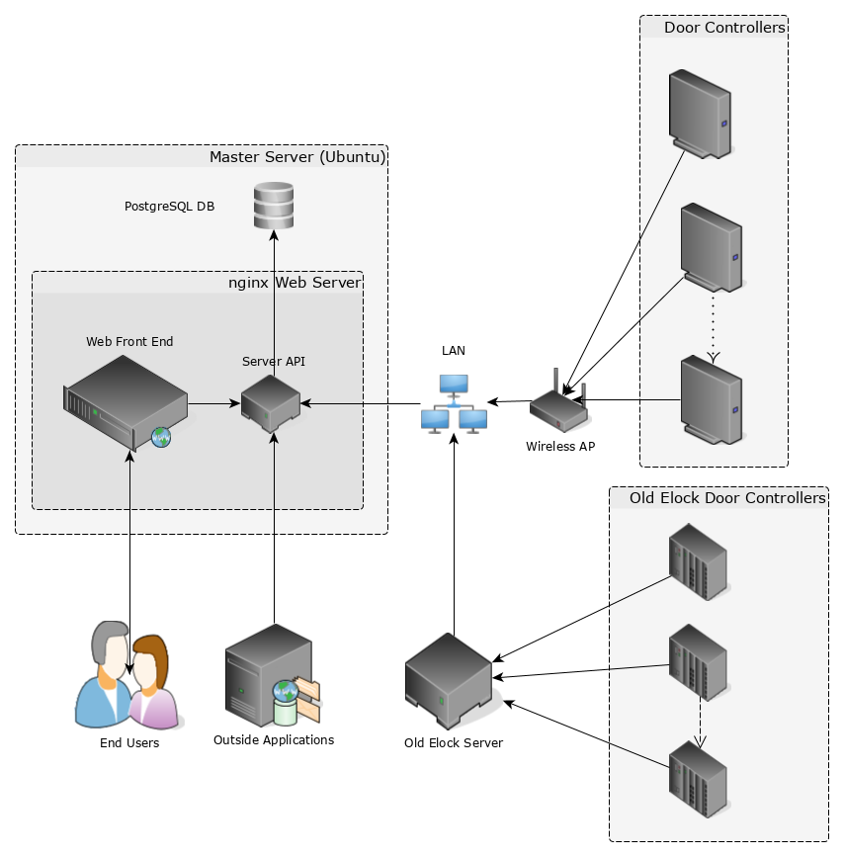
Overall Architecture
Arrows point in the direction of initiation of requests.

Slide 8

Elock Frontend
The frontend that people interact with.

Slide 9
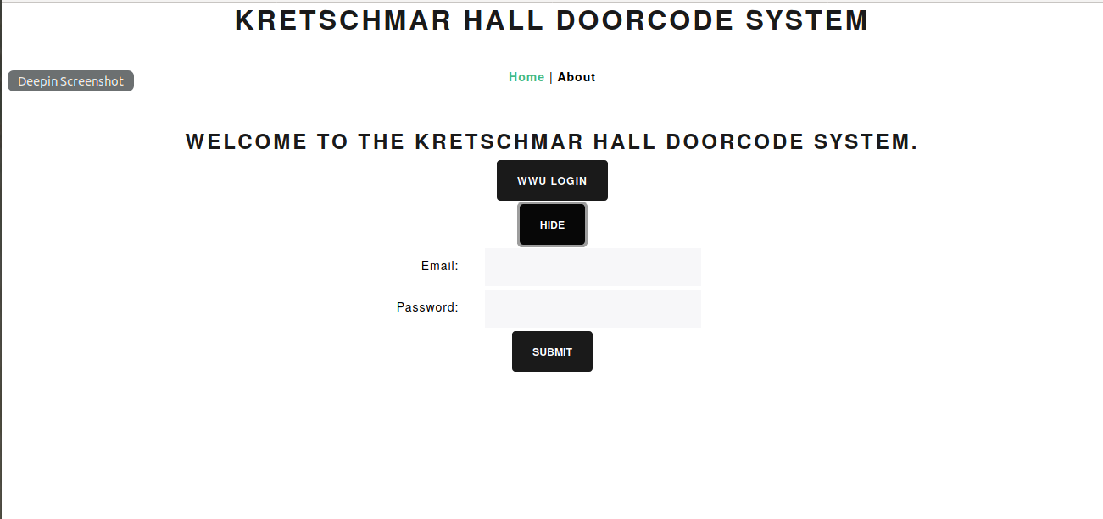

Slide 10
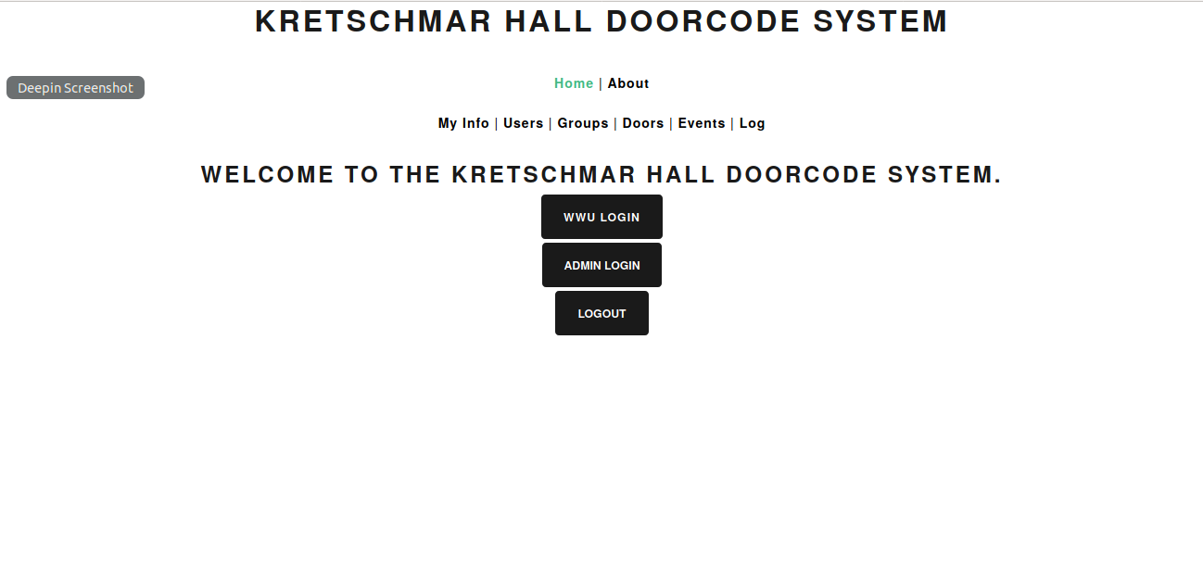

Slide 11
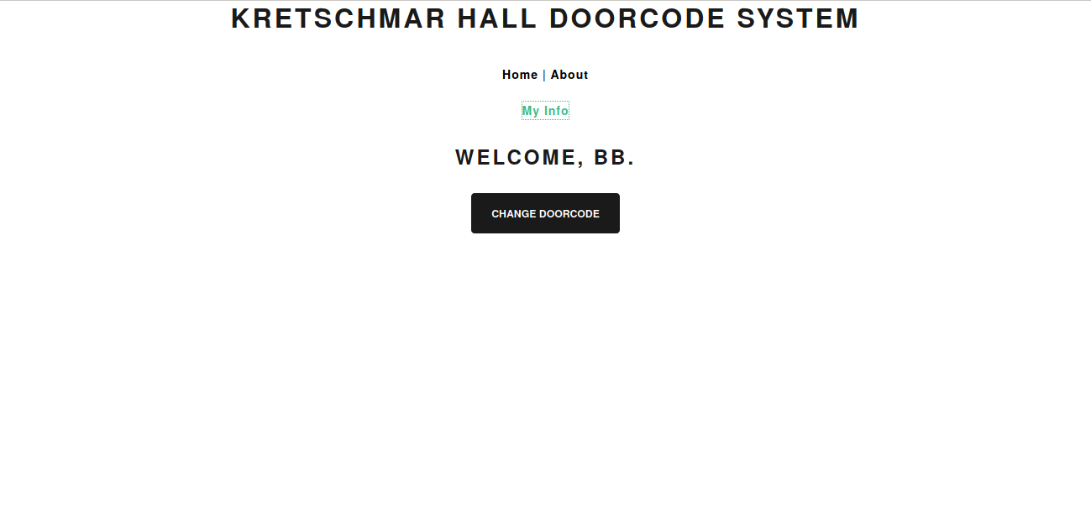

Slide 12
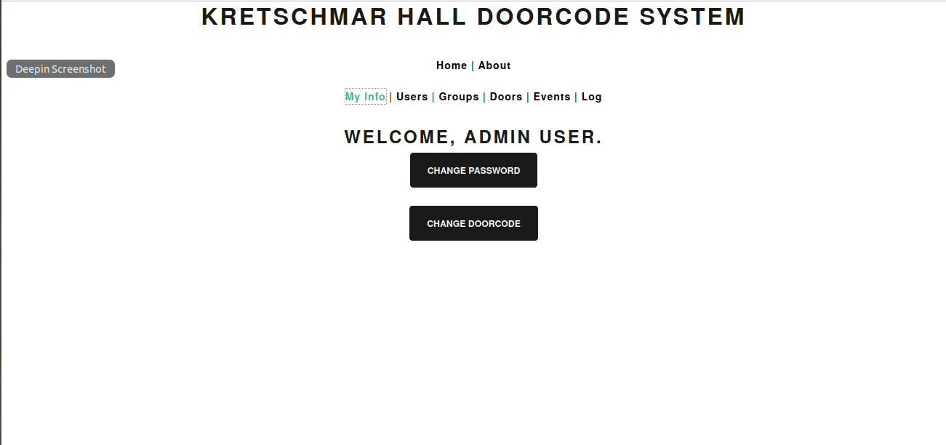

Slide 13
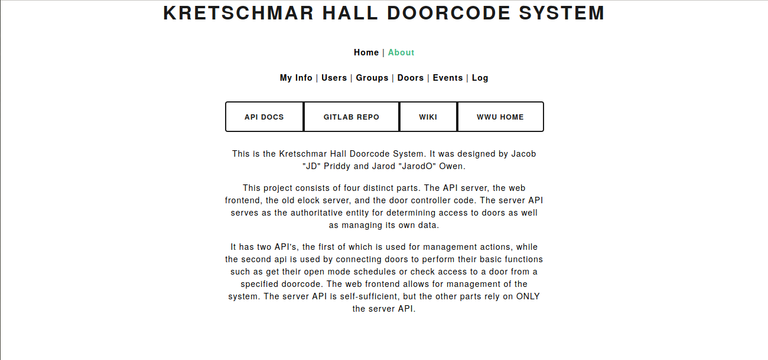

Slide 14
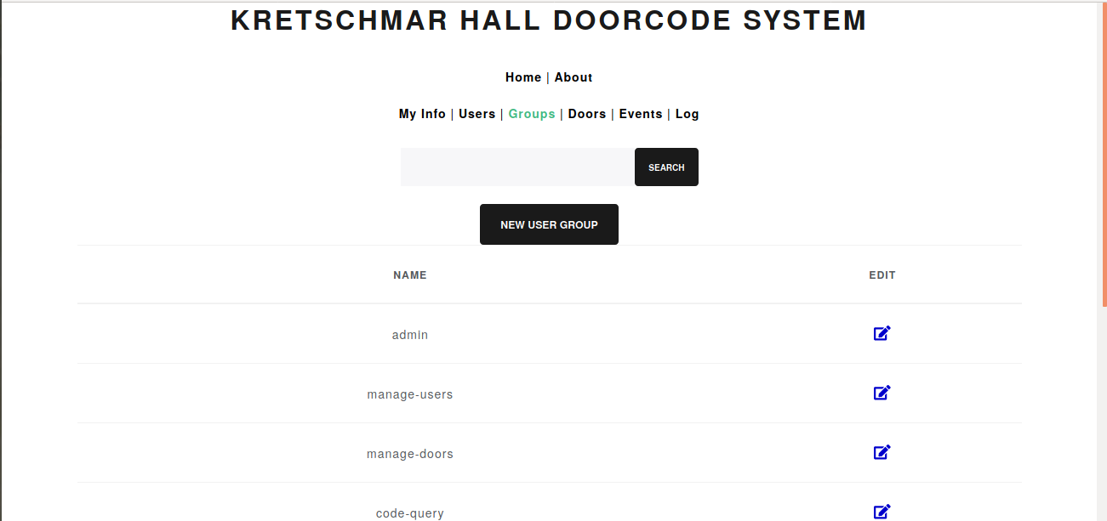

Slide 15
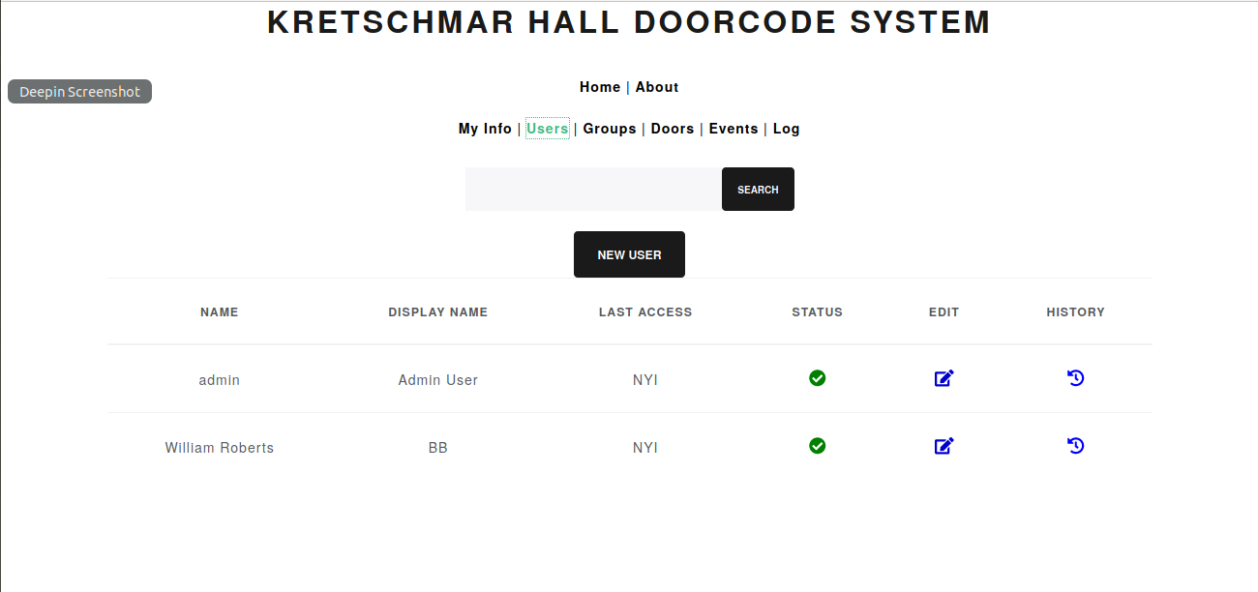

Slide 16
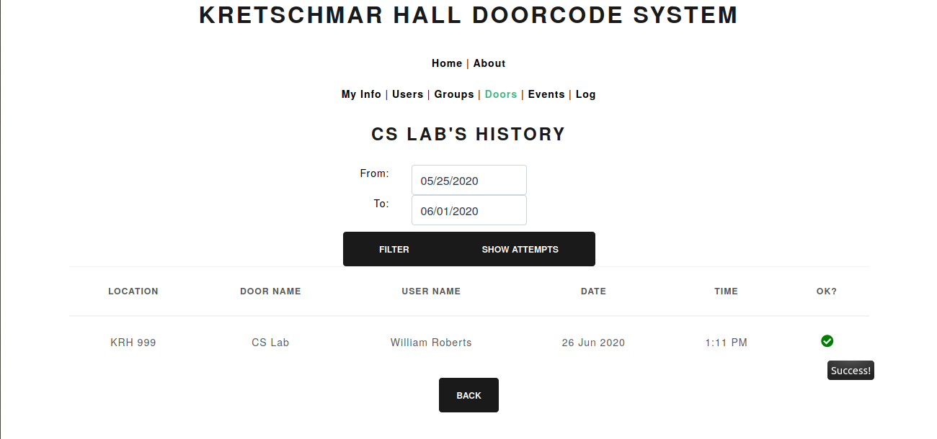

Slide 17
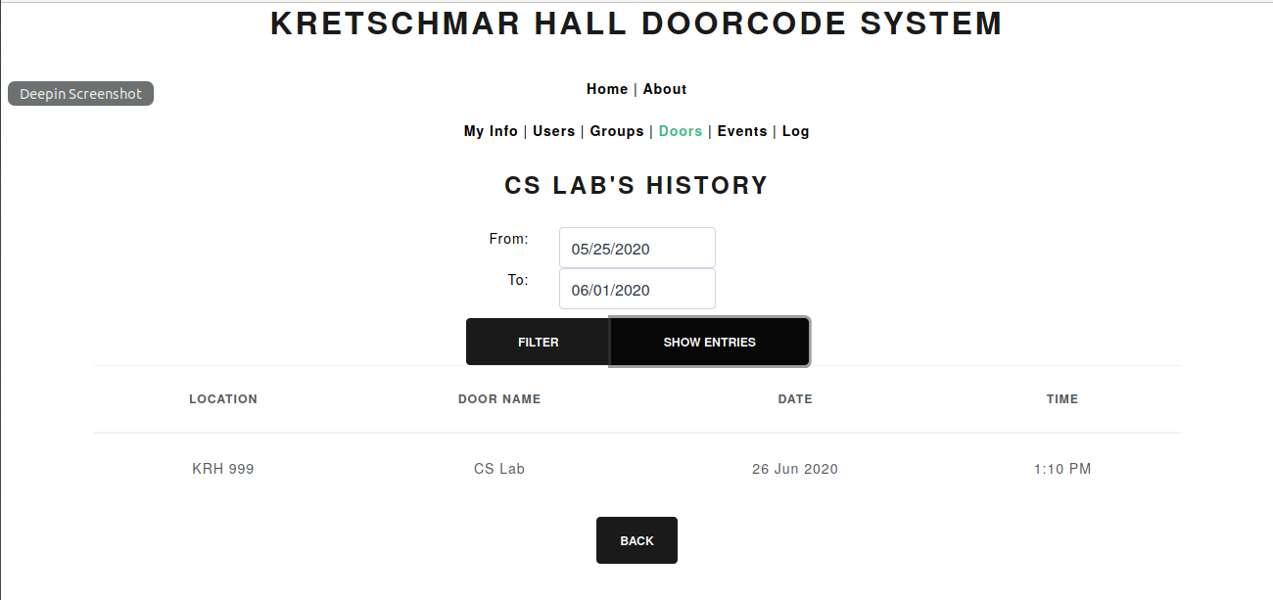

Slide 19
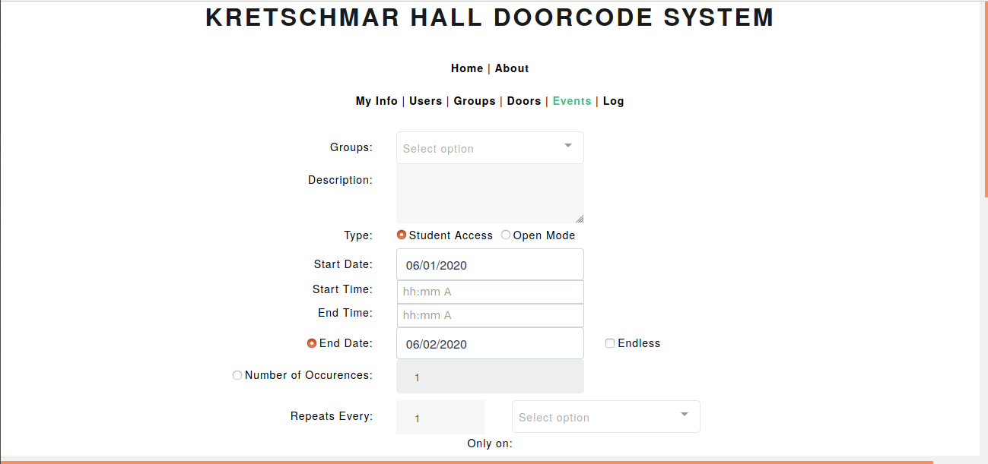

Slide 20
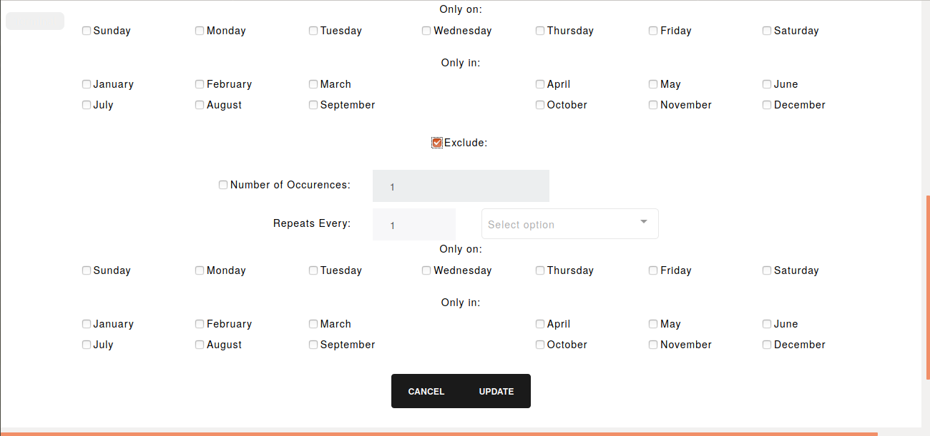

Slide 21

Elock API
The backend that drives the system.

Slide 22
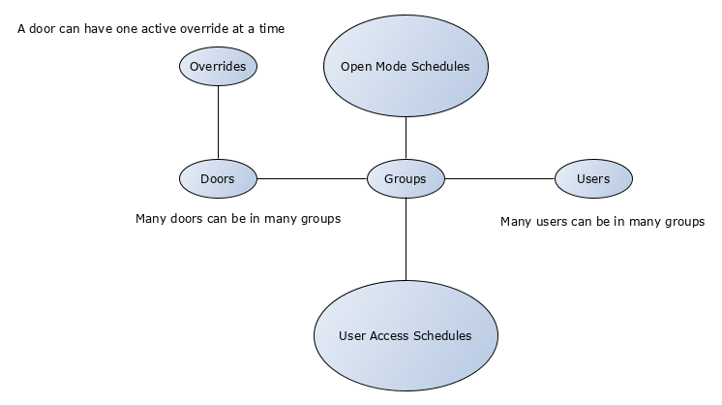
Access Relationships
How doors, users, groups, overrides, access schedules, and open mode schedules are related

Slide 23
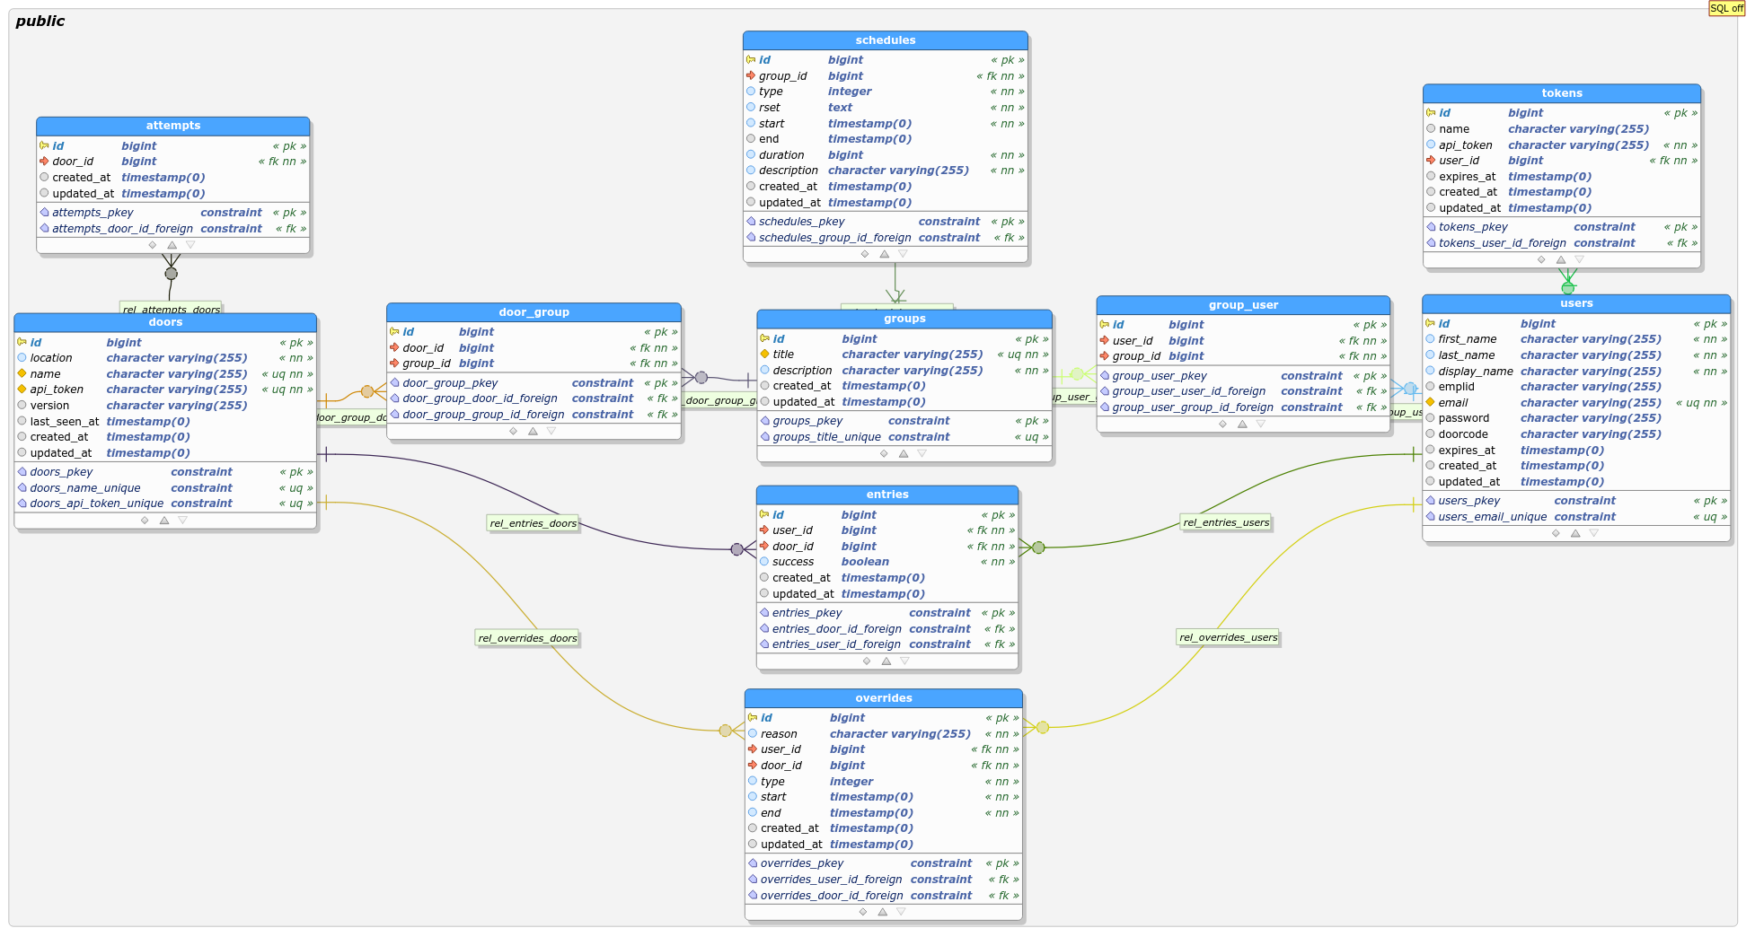
Database Structure

Slide 24
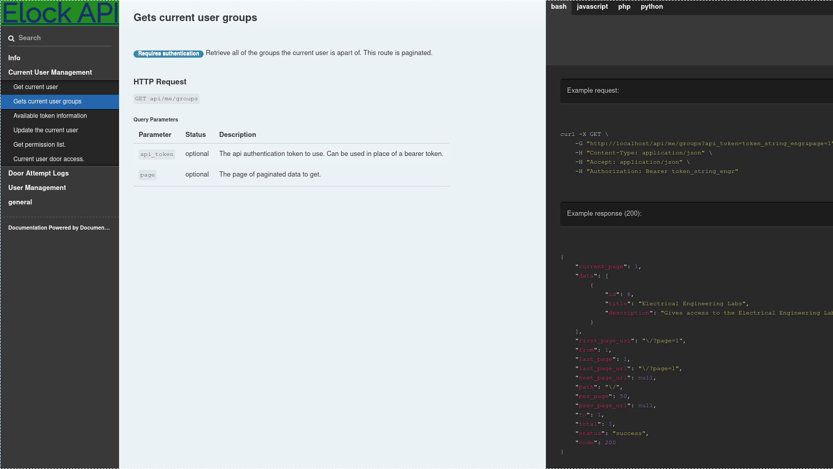
API Docs
API has nice public documentation

Slide 25
Features
Well documented API for outside applications
Ability to let students/faculty/staff change their own doorcode by logging into University ADFS
Token delegation system for external applications
User/Group/Door/Schedule/Override management
Access logs with filtering
Door controller API for determining access and open times

Slide 26
Deployment
The project is live at https://elock.cs.wallawalla.edu
Not fully integrated with University ADFS yet...
Project has full CI/CD for easy development environment setup and deploy of changes

Slide 27

Door Controllers
The devices controlling access to individual doors.

Slide 28
ESP32 Specs
4MB Flash (Partitioning leaves 1MB for the application)
2-32bit LX6 processors
520 KB SRAM
WiFi Capability
Runs on FreeRTOS

Slide 29
Door Controller Features
Written in C because of development constraints.
Connects through WiFi for ease of installation and replacement
Updates door state every 15 minutes and on access requests to API
Does not make requests to API when in open mode (except for the 15-minute period state update)
Automatically checks for an update every day and if there is a new version will update itself. If the update fails it will roll back to the previous version of the application

Slide 30
Door Controller Improvements
Old Controllers
New Controllers
Written in assembly
Needs to be polled many times a second
Does not natively support door commands
Cannot be updated or reflashed as the technology is very old.
Written in C
Self-sufficient. Talks to the API to get the information it needs
Natively supports door commands
Automatically updates themselves via OTA

Slide 31
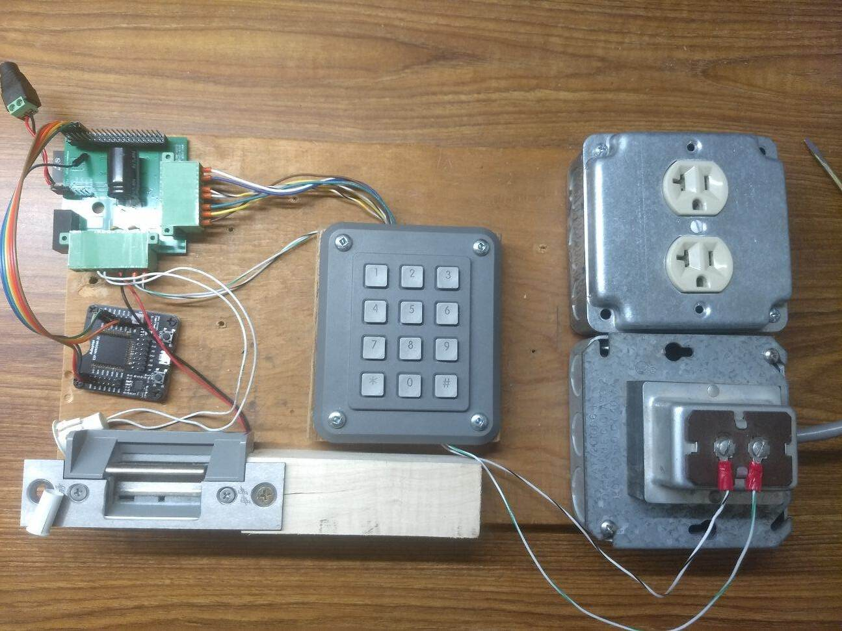
Test Board
Keypad
ESP32 and PCB
Flasher
Door Strike
Power Supply

Slide 32
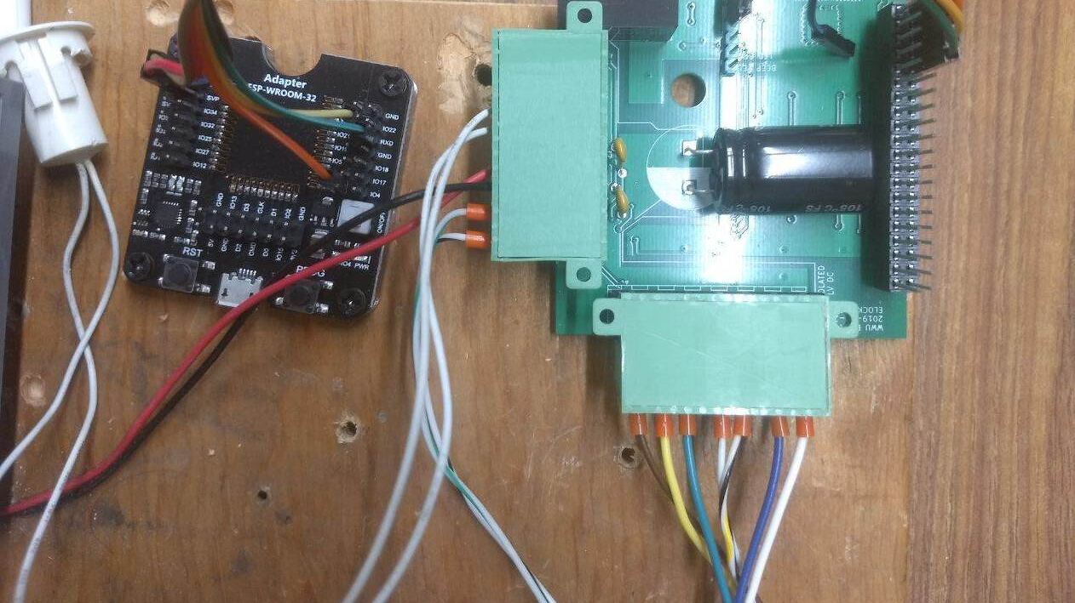
PCB and ESP32 Flasher
Black board is the flashing tool. ESP32 is on the bottom of the PCB. White cylinder on the left detects if the door is open or closed.

Slide 33
Development and Deployment
Project is setup with a docker container for running and testing code.
Gitlab CI and CD is setup for the project to ensure the ease of any needed changes
Deployments are sent to the API ready to be served to any out of date door controllers.

Slide 34
Migration of Old System
Translating to new API Requests

Slide 35
Migration Process
Old system uses a client server model which is compatible with the new system.
Migrated doors
Migrated users
Hooked into old code to make API requests to the new system instead of checking old database

Slide 36
Results
All currently working doors have been migrated and are running on the new project
Old system no long supports door commands as it was a "crude implementation that had [existing] problems."

Slide 37

Questions?
I'm perfectly okay if you don't have any...

Slide 38
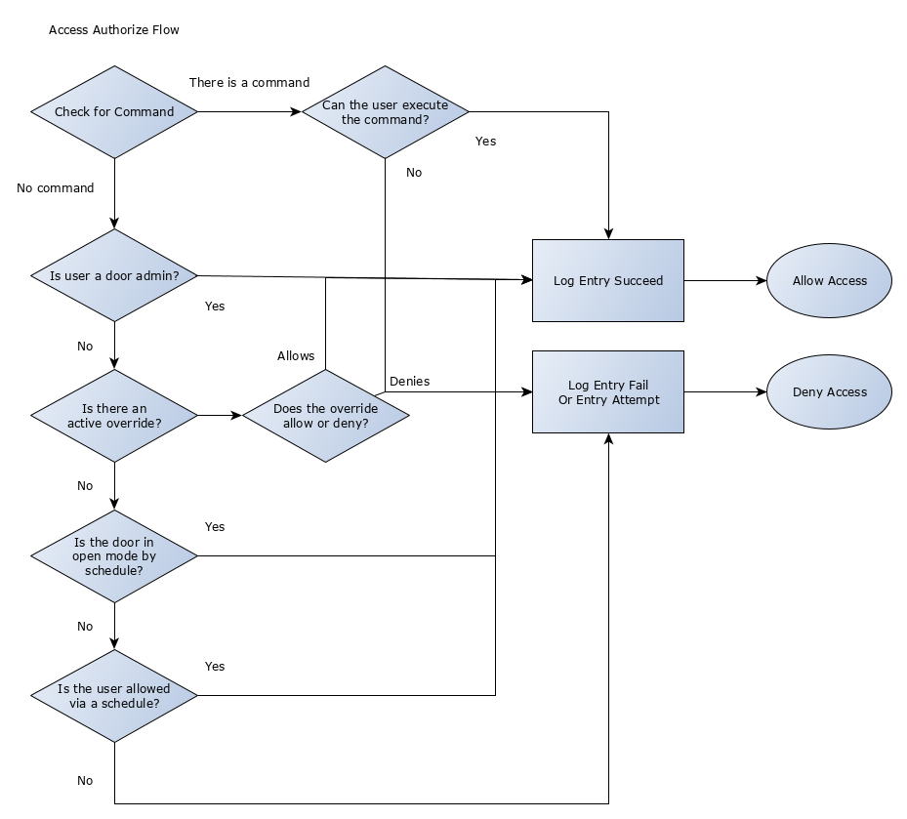
Access Authorize Flow
How the application processes a door access request.

